Slide 1
Controlling The Performance In a Developed Large Institute

Slide 2
Agenda
Introduction
Primary goals
Areas of growth
Summary

Slide 3
Introduction

Slide 4
Primary goals
CV application in factories

Slide 5
Application of CV in a Factory
Safety
Quality Inspection
Crowd detection
Workers tracking
Applications

Slide 6
Safety
Custom Detection
Fainted or Drowsy

Slide 7
Custom Detection

Slide 8
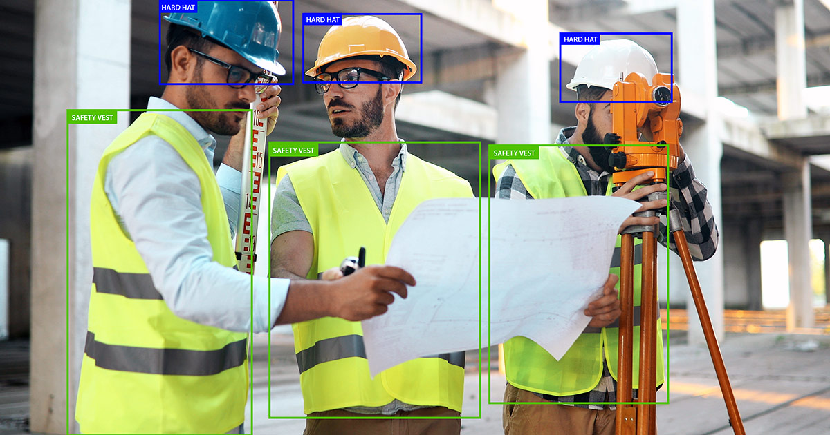

Slide 9
Fainted or Drowsy

Slide 10
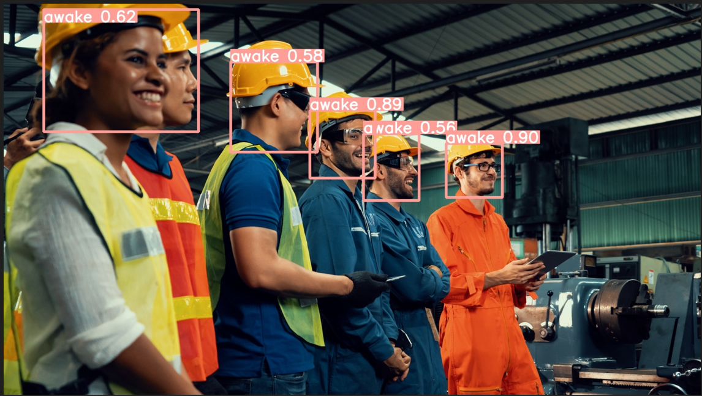

Slide 11
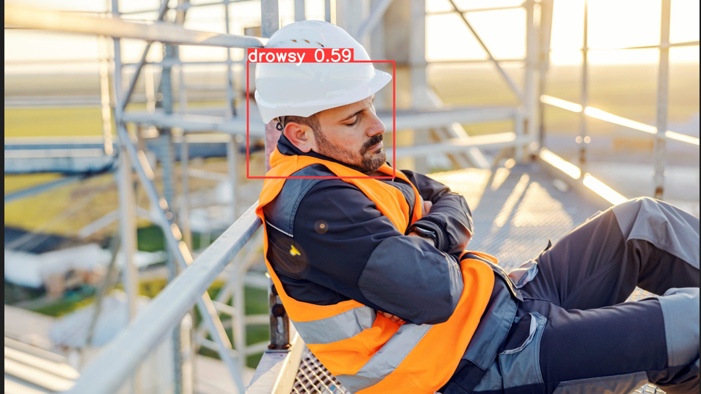

Slide 12
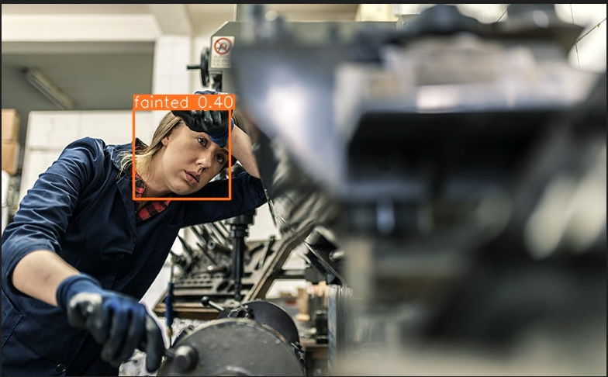

Slide 13
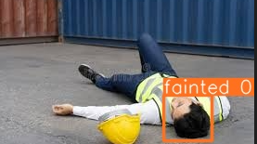

Slide 14
Quality Inspection
Automated Visual Inspection
Defects Detection and classification

Slide 15
Automated Visual Inspection

Slide 16


Slide 17
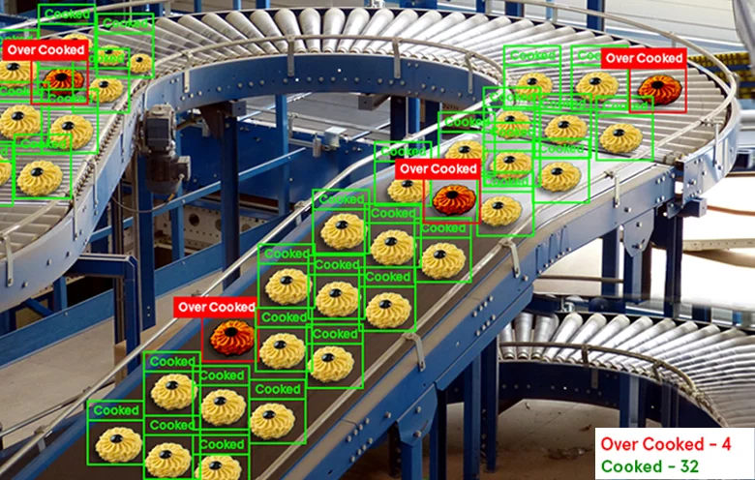
Example on the AVI

Slide 18
Detection of defects

Slide 19
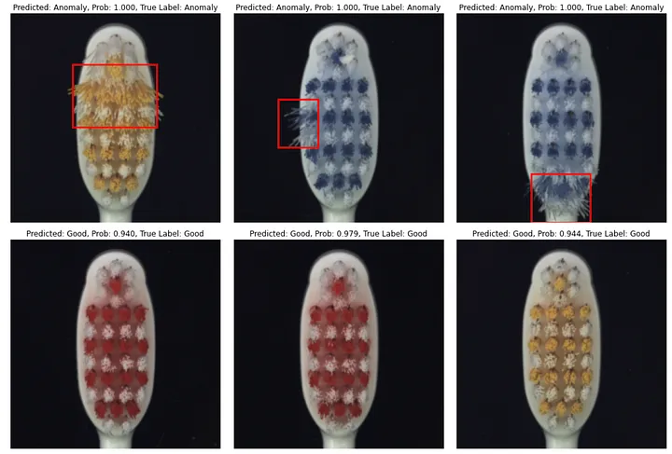

Slide 23
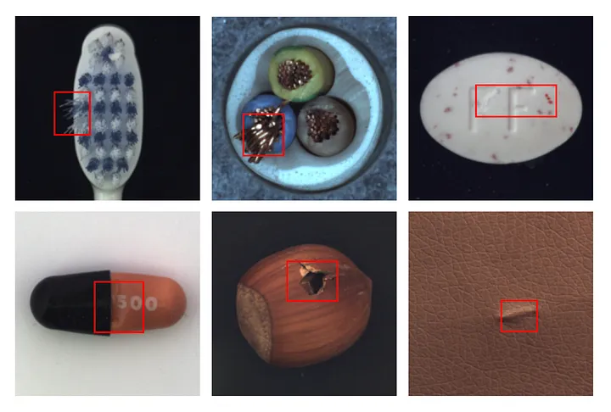

Slide 25
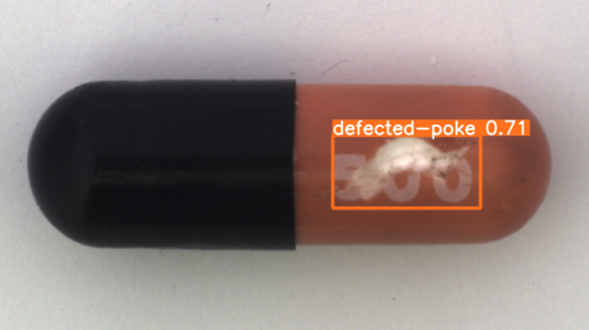

Slide 27
Classification of defects

Slide 28
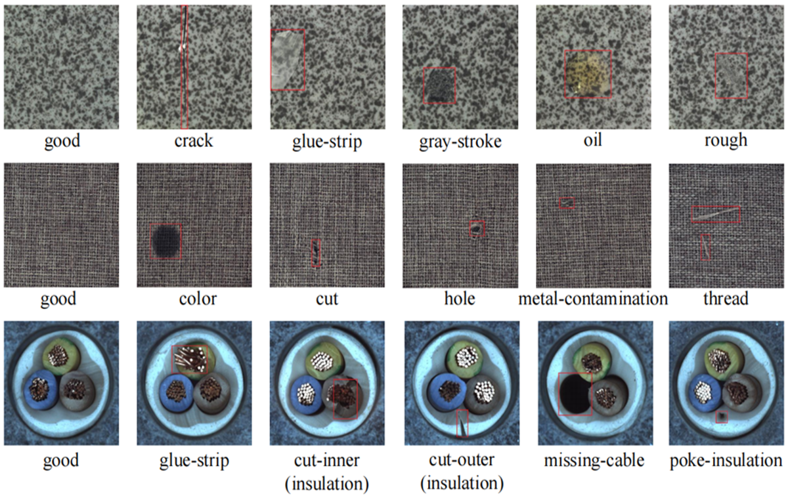

Slide 36
Crowd Detection

Slide 37


Slide 38
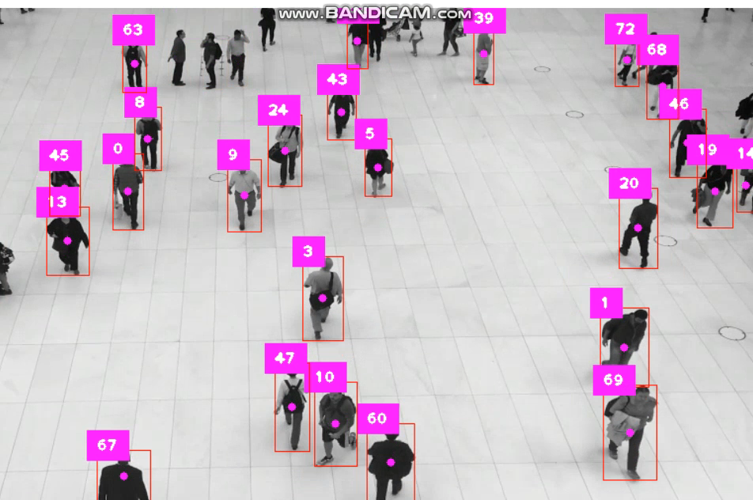

Slide 39
Embedded systems

Slide 40
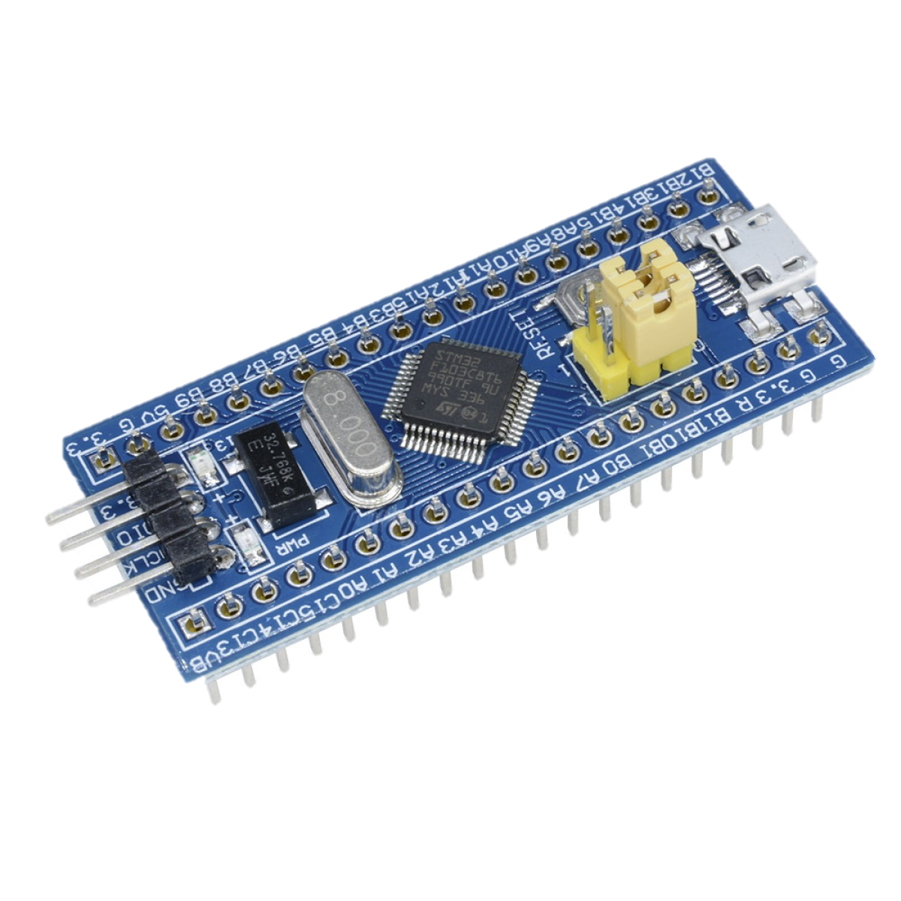
Main Microcontroller
STM32F103C8T6

Slide 41
Communication protocol

Slide 42
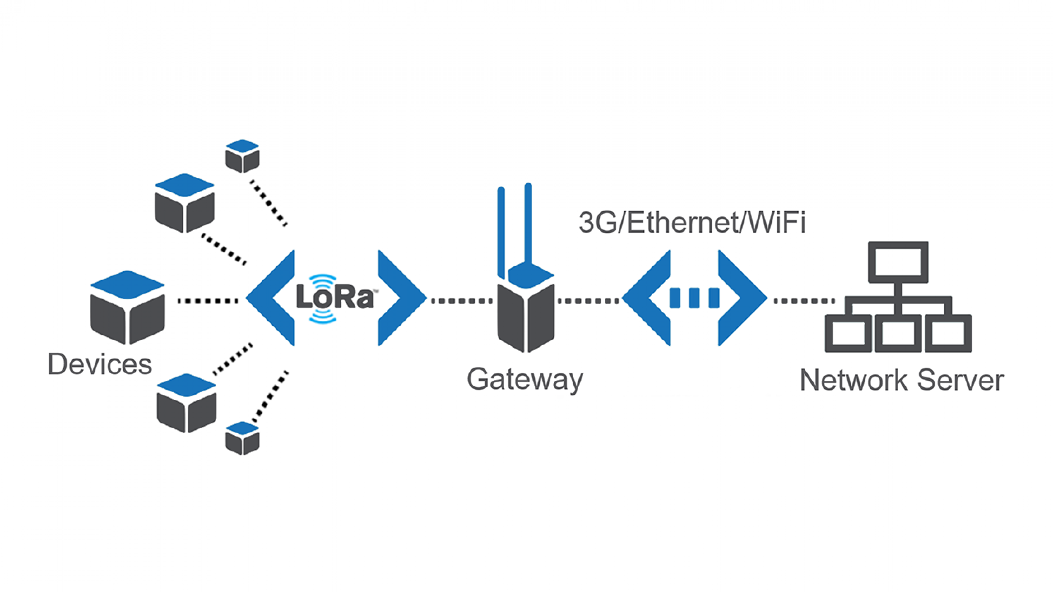
LORA Technology

Slide 43
Environmental Monitoring

Slide 44
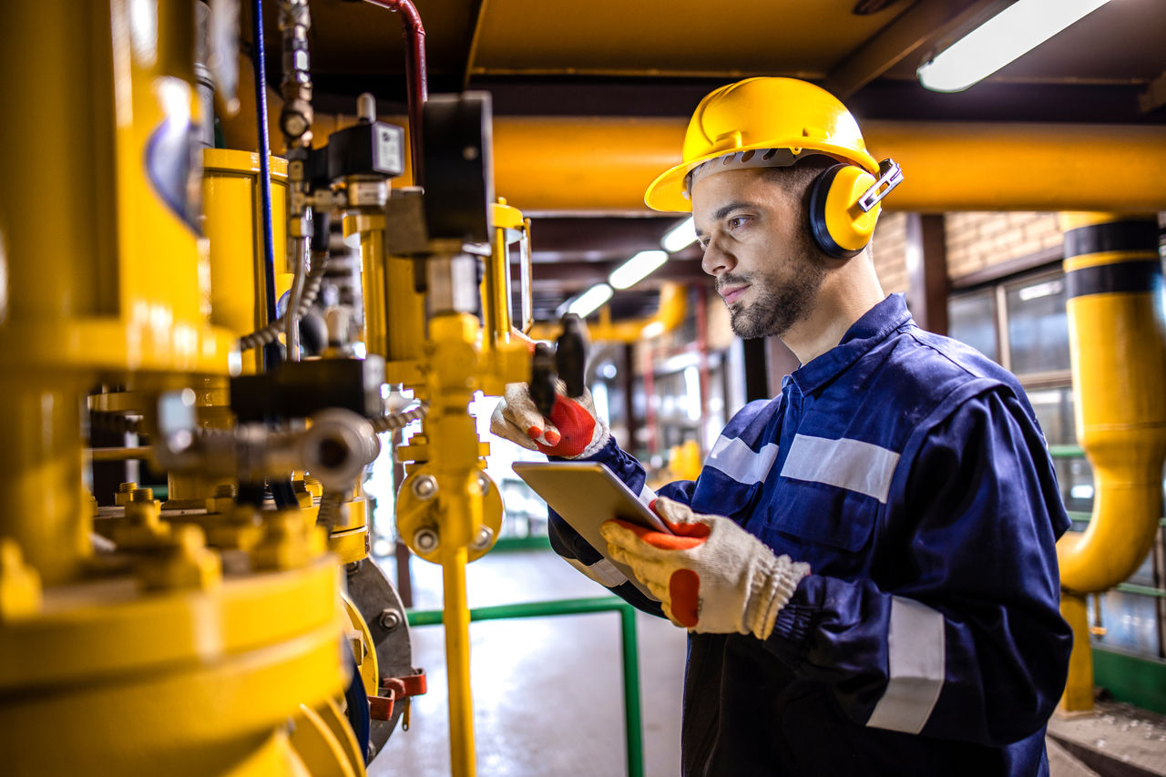

Slide 45
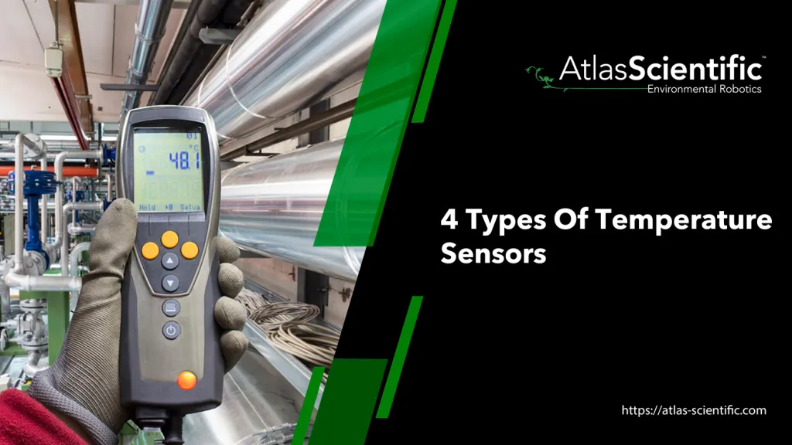
Temperature& Humidity Monitoring

Slide 46
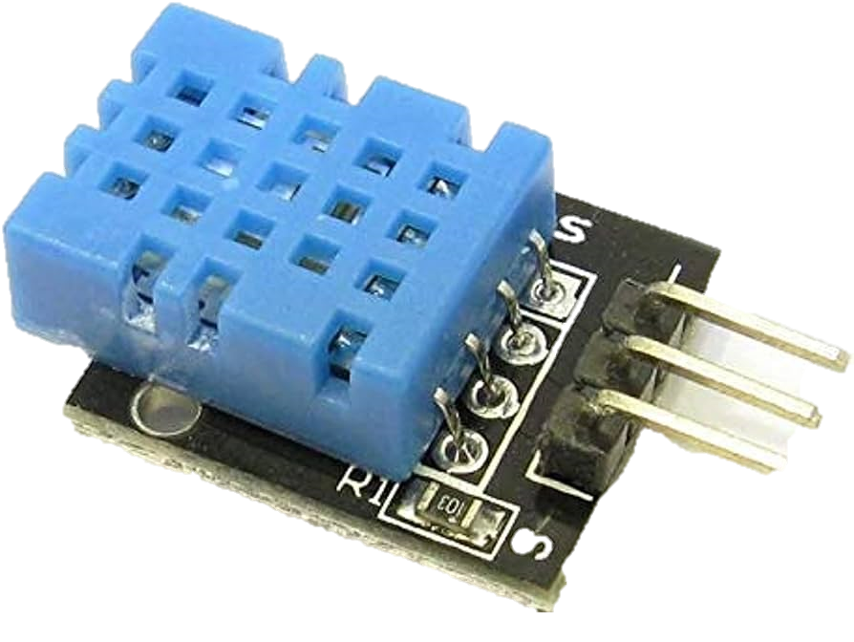
DHT 11 Sensor

Slide 47
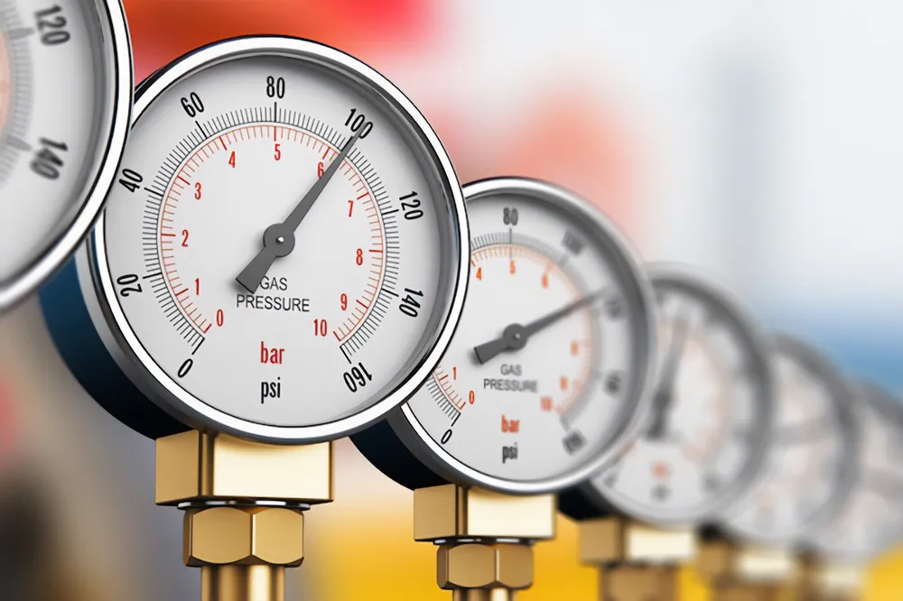
Pressure Monitoring

Slide 48
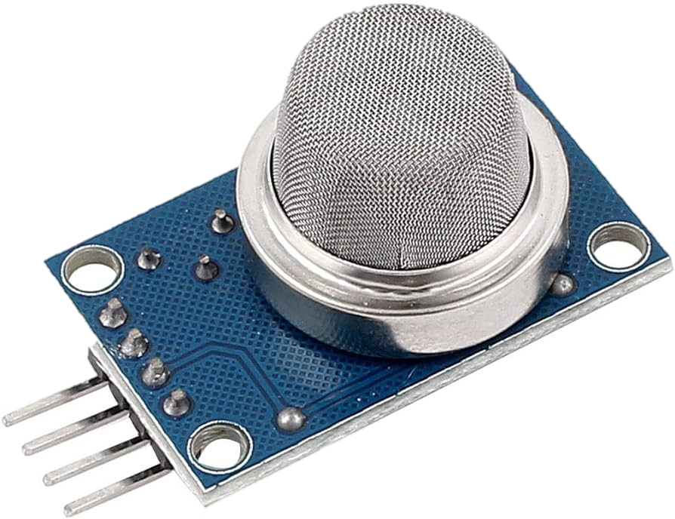
MQ Sensor

Slide 49
Desktop Application

Slide 50
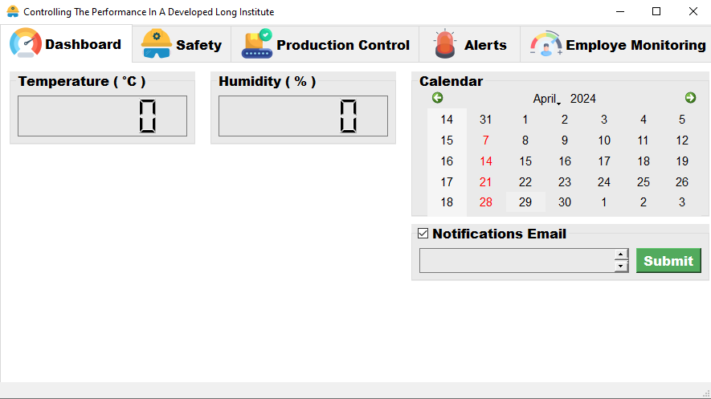

Slide 51
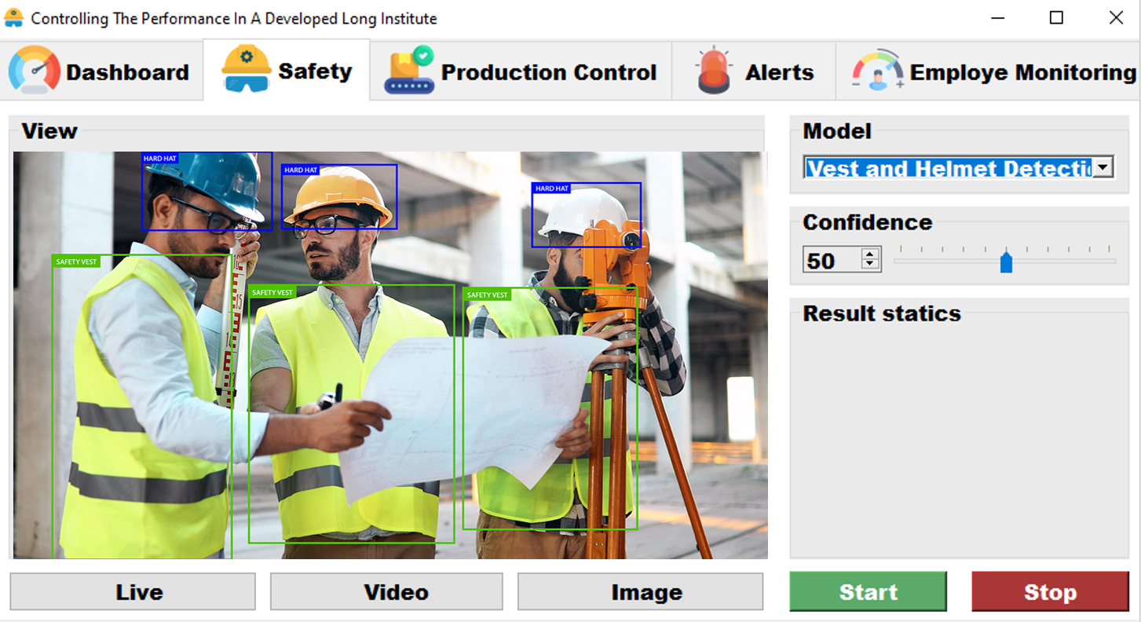

Slide 52

Thank you

